Slide 1


Lecture 25
Produced by Dr. Worldwide
Welcome to the 305
~
~

Slide 2


Descriptive Statistics
Current methods are appropriate for univariate data
Bivariate data contains observations from a pair of variables
For bivariate data, the focus shifts to understanding the relationship between the two variables
Descriptive statistics for bivariate data
Scatterplot
Covariance
Correlation
Since the most widely used method for modeling relationships is linear regression, the scatterplot is often use to inspect if a linear relationship exists

Slide 3
Ex: Sum of Dice
Q: What kind of relationship exists between the outcomes of the two dice?
Q: What kind of relationship exists between the outcome of the second die and the sum of the two dice?
Download SumDice-2.xlsx from link Sheet 1 on course website
In Excel, create a scatterplot by using the Insert menu
Optionally, use Recommended Charts to help you select Scatter
Examine plots in tab named “50” and “100” for examples
Investigate the plots to determine if your hypotheses were true

Slide 4
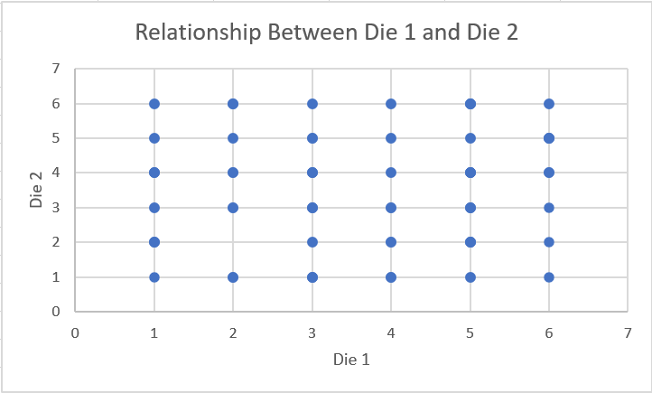
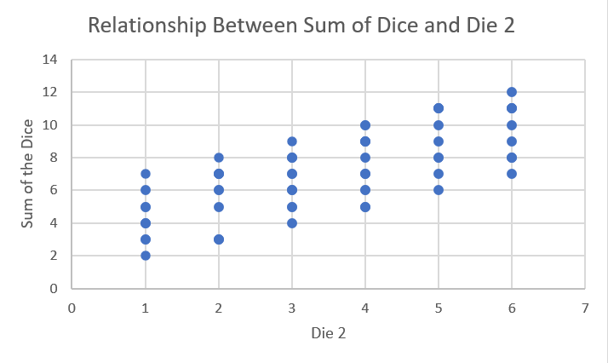
Ex: Sum of Dice
Plots based on 100 observations from the population
Q: How would we quantify the difference between these relationships?

Slide 5
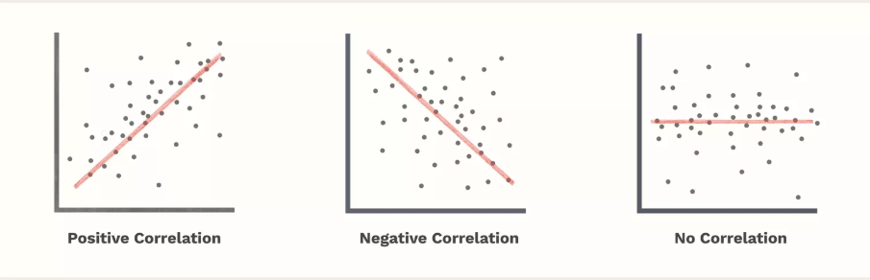
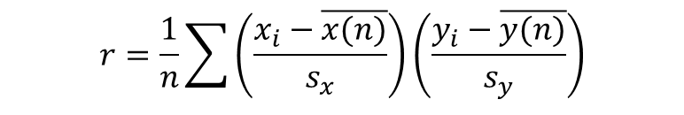
Descriptive Statistics
The sample correlation coefficient measures the strength of linear relationship between two variables on a scale between -1 and +1
Close to 1 implies strong positive correlation
Close to -1 implies strong negative correlation
Close to 0 indicates no correlation
Formula
$$r=\frac{1}{n}\sum{\left(\frac{x_{i}−\overline{x(n)}}{s_{x}}\right)\left(\frac{y_{i}−\overline{y(n)}}{s_{y}}\right)}$$

Slide 6



Ex: Sum of Dice
Calculation of correlation using CORREL(variable 1, variable 2)
When n=50
When n=100
When n=200

Slide 7
Descriptive Statistics
Previous statistic is often called Pearson’s correlation coefficient
Assumptions for Pearson’s correlation coefficient
Both variables are normally distributed (approximately bell-shaped)
Relationship can be expressed by a line
Data is equally distributed around the best-fitted line
Spearman’s correlation coefficient is the nonparametric version of the latter and evaluates the monotonic relationship between the ranked values
Monotonic implies that variables change together but not at a constant rate
Both correlation coefficients are between -1 and 1

Slide 8
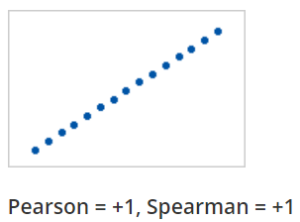
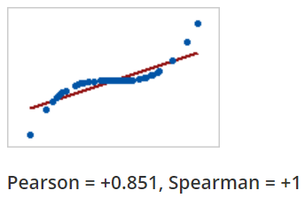
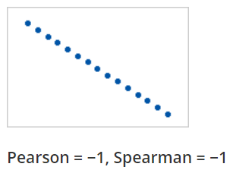
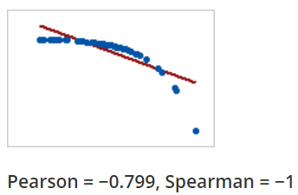
Descriptive Statistics
Visual difference between Pearson and Spearman

Slide 9
Descriptive Statistics
Advantage of Spearman’s is that it can be applied to discrete numeric and ordinal categorical data
Formulation is based on ranking the observations for each of the variables and computing the Pearson correlation coefficient for the ranks
When ranking, we handle ties by computing the average
Evaluation of Spearman’s correlation coefficient
=RANK.AVG(observation, variable, 0=descending)
=CORREL(RANK.AVG(variable 1),RANK.AVG(variable 2) )

Slide 10
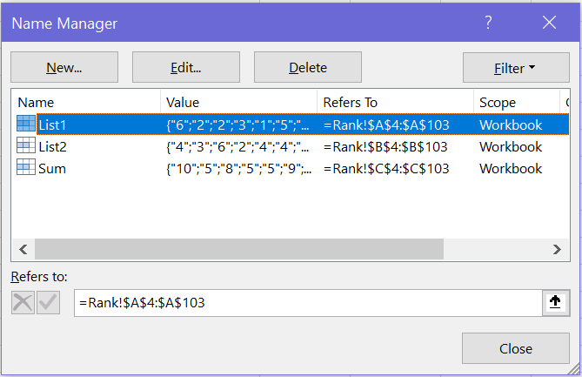

Ex: Sum of Dice
Calculation of Spearman’s correlation in tab named “Rank”
Create variables for first die roll, second die roll, and sum of dice
Create columns of ranks using RANK.AVG
Use CORREL function on ranked columns

Slide 11
PivotTables
The PivotTable is a powerful tool to calculate, summarize, and analyze data
The purpose is to organize and summarize the data in a way that can be used to answer questions or visualize patterns
Two tutorials provided on the course website
Tutorial from Excel Easy is found in Link 1 on course website
Tutorial from Microsoft Support is found in Link 2 on course website
Many YouTube videos in addition to these two tutorials
Companies use Excel’s PivotTables as their main tool for summarizing data making competency in this area extremely marketable

Slide 12
Ex: Cancer Research
Download CancerResearch.xlsx from link Sheet 2 on course website
Results form a PubMed search on the topic “Non-small lung cancer”
Dataset contains 10 fields
Article ID number (pmid)
Year of publication (year)
Month of publication (month)
Day of publication (day)
Journal ID number (journ_id)
Journal title (journ_name)
Article title (title)
Article abstract (abstract)
Author’s affiliations (aff)
Number of authors (num_auth)

Slide 13
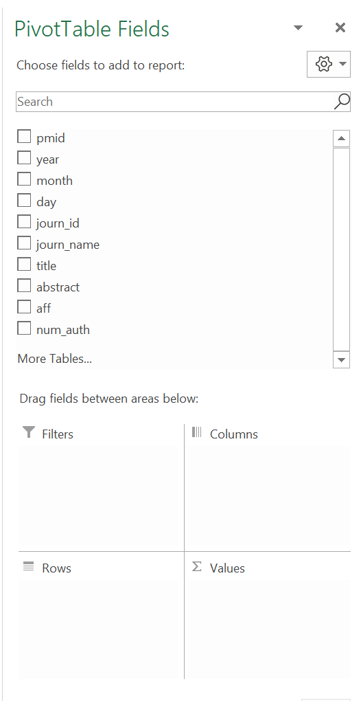
Ex: Cancer Research
Select all data: Select cell A1 (top-left) and use the shortcut Ctrl+Shift+Down+Right to automatically select all the data
When selecting the data include column names in selection
Go to Insert menu to find PivotTable in the far left
By default, this operation will generate a new tab
Menu bar is used to customize the PivotTable

Slide 14
Ex: Cancer Research
Aspects of the menu bar
PivotTable Fields: Box containing all the variables from selection
Filters: Box where you can select fields to filter the rows
Columns: Field(s) used to define the columns of the table
Rows: Field(s) used to define the rows of the table
Values: Type of summary statistic that the table should display
Possible summary statistics
Sum
Count
Average
Max
Min
Product
StdDev
Var

Slide 15
Ex: Cancer Research
Q: When was the research on non-small cell lung cancer most active?
Q: What journals published more papers on that topic?
Q: What institutions have conducted the most research in this area?
Q: What was the average number of authors for each journal?
Q: What other questions could we explore in this dataset?
Go to tab named “Pivot Table” and play around with the example or create your own tab and start from scratch

Slide 16
PivotCharts
PivotCharts are visual representations of the PivotTable
Create PivotCharts through the Insert menu after selecting data
Different options in menu bar
PivotChart Fields: Box containing all the variables from selection
Filters: A box where you can select fields to filter the axis labels
Legend(Series): Field(s) that will be used to create legends
Axis (Categories): Field(s) used to define axis labels
Values: Type of summary statistic that the chart should summarize
The default PivotChart is a barplot but many other options exist
When chart is selected, go through the Design menu to find Change Chart Type

Slide 17




The End
Dale

